Slide 1
Group Discussion: “Exploration by Random Network Distillation”
Scott O’Hara
Metrowest Developers Machine Learning Group
01/16/2018

Slide 2
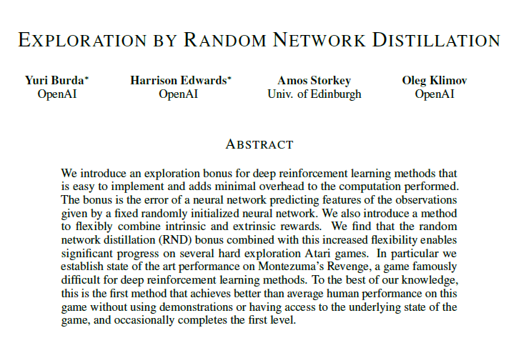

https://arxiv.org/pdf/1810.12894.pdf

Slide 3
Reinforcement Learning: the basic idea
Select an action.
If action leads to reward, reinforce that action.
If action leads to punishment, avoid that action.
Basically, a computational form of Behaviorism (Pavlov, B. F. Skinner).

Slide 4
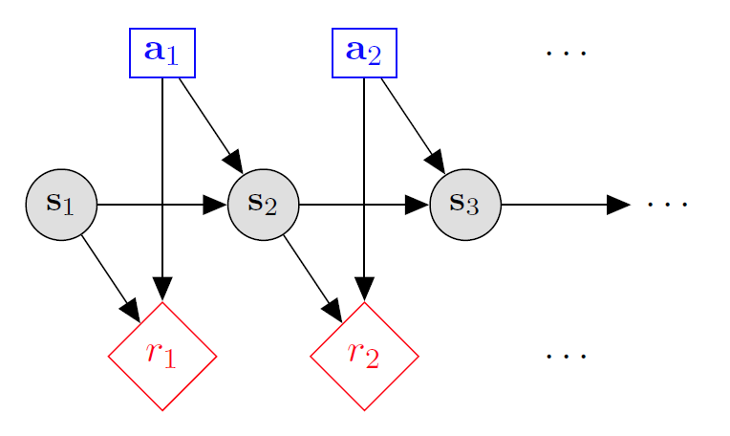

Markov decision processes
States: $s_{1},…,s_{n}$
Actions: $a_{1},…,a_{m}$
Reward Function:
$r\left(s,a,s′\right)∈R$
Transition model:
T(s,a,s’)= $P\left(s′ | s, a\right)$
Discount factor: $γ∈\left[0,1\right]$
<https://en.wikipedia.org/w/index.php?title=Markov_decision_process&oldid=855934986> [accessed 11 September 2018]

Slide 5
Reinforcement Learning
Agent
State: s’
Reward: r
Actions: a
Environment
Agent knows the current state s, takes action a, receives a reward r and observes the next state s’
Agent has no access to reward model r(s,a) or transition model p(s’|s,a)
Agent must learn to act so as to maximize expected rewards.
All learning is based on observed samples of outcomes!

Slide 6
choosing an action: exploration vs exploitation
How should an agent choose an action? An obvious answer is simply follow the current policy. However, this is often the best way to improve your model.
Exploit: use your current model to maximize the expected utility now.
Explore: choose an action that will help you improve your model.

Slide 7
How/When should we explore / exploit ?
How to Exploit? use the current policy.
How to Explore?
choose an action randomly
choose an action you haven’t chosen yet
choose an action that will take you to an unexplored state.
When to exploit? When to explore? How much time in exploration vs time in exploitation?

Slide 8
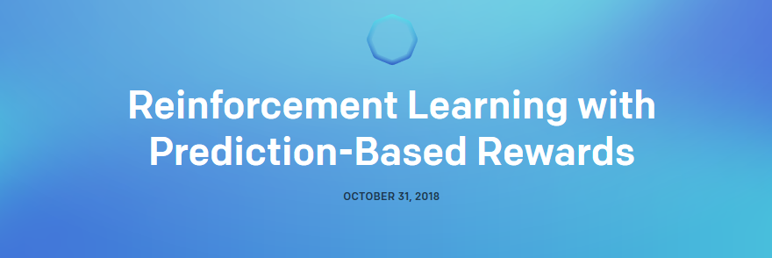
https://blog.openai.com/reinforcement-learning-with-prediction-based-rewards/

Slide 9
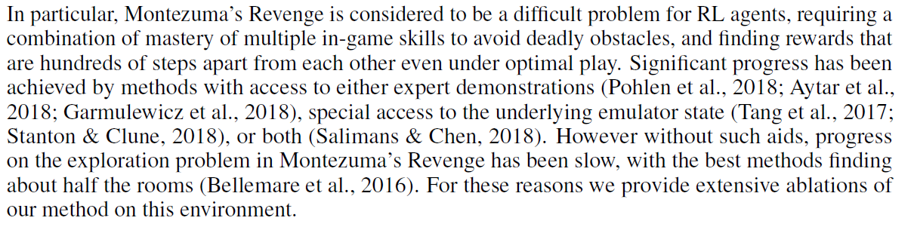

Why Montezuma’s Revenge is hard

Slide 10
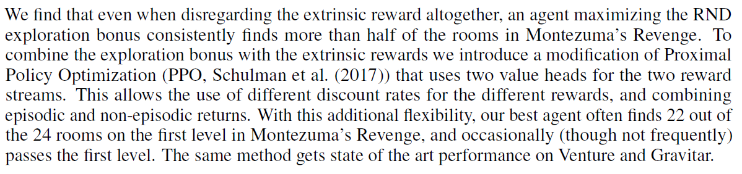
What RND contributes

Slide 11
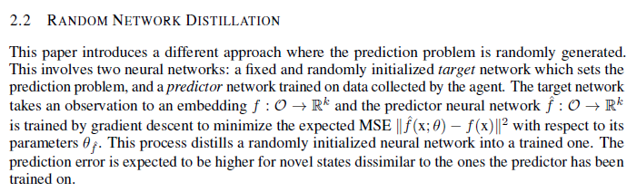





Random network distillation

Slide 12
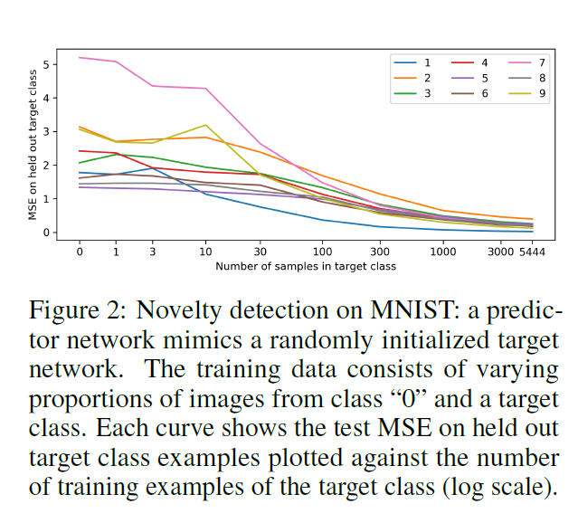

Slide 13
Supplemental slides

Slide 14
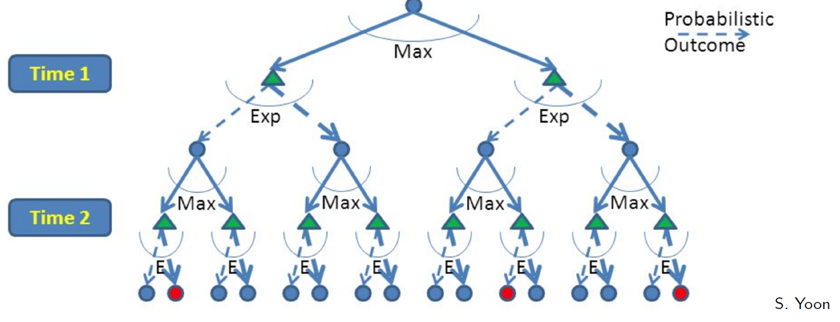
RL is like A game against Nature
Reinforcement learning is like a game-playing algorithm.
Nodes where you move are called states: S ( )
Nodes where nature “moves” are called Q-states: <S,A> ( )
Credit: CS188 – Intro to AI, UC Berkeley, ai.berkely.edu

Slide 15

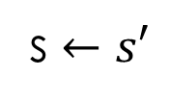
Q-Learning algorithm
For each state s and action a:
$Q\left(s,a\right)←0$
Begin in state s:
Repeat:
Given s and the set of actions $A_{s}$associated with s:
CHOOSE ACTION $a∈A_{s}$ ← HOW?
Apply action a.
Receive reward r and new state s’.
With transition <s,a,r,s’>, update Q(s,a)
$$Q\left(s,a\right)←\left(1−α\right)Q\left(s,a\right)+α\left[r+γ\max_{a′}{Q_{k}\left(s′,a′\right)}\right]$$
s $←s′$

